Slide 1
caGrid Data Services Hackathon
caGrid Knowledge Center
https://cabig-kc.nci.nih.gov/CaGrid/KC
Sept 14, 2009

Slide 2
Tutorial prep work

Slide 3
caGrid Software Installation
Prerequisite
Please verify that you have the Java 6 SDK installed. (http://java.com)
Installation
Copy the hackathon.zip from the USB stick to C:\ (or your home directory if on Mac or Linux) and expand it in C:\
This creates a new directory C:\hackathon
The caGrid 1.4 Installer: C:\hackathon\caGrid-installer-1.4
caGrid 1.4: C:\hackathon\caGrid
Apache Ant: C:\hackathon\apache-ant-1.7.0
Globus Toolkit for Java: C:\hackathon\ws-core-4.0.3
IMPORTANT NOTE: if you have previously installed caGrid, please rename or move the .cagrid\installer-1.4 directory in your home directory (e.g., C:\Documents and Settings\Username or ~/.cagrid/installer-1.4) Don’t delete ~/.cagrid itself as it contains your security certificates.

Slide 4
caGrid Software Installation
Configuration
Set the following SYSTEM environment variables
JAVA_HOME is set to your JDK directory
ANT_HOME=C:\hackathon\apache-ant-1.7.0
GLOBUS_LOCATION=C:\hackathon\ws-core-4.0.3
CATALINA_HOME=C:\hackathon\apache-tomcat-5.5.27
Add “;%ANT_HOME%\bin;%JAVA_HOME%\bin” to the end of your SYSTEM path.
Additional software included in hackathon.zip:
Notepad++, A free file editor application: C:\hackathon\notepad++
Software Distributions: C:\hackathon\dist
Completed PODS Data Service: C:\hackathon\PODSDataSvc-solution

Slide 5
Mac / Linux Settings
This tutorial assumes you are using Windows XP or Vista with the tutorial installed at C:\hackathon. With some simple modifications, you can run the tutorial in an OS X or Linux environment.
Steps to run on OS X or Linux:
Copy build.xml to build.windows.xml
Copy build.unix.xml to build.xml
Replace the text “PATH_TO_HOME_DIR” in caGrid-installer-1.4/download.unix.properties and caGrid-installer-1.4/cagrid.installer.unix.properties with the path name to your home directory.

Slide 6
caGrid overview

Slide 7

What is caGrid?
A grid based software infrastructure consisting of services, toolkits, APIs, and applications
A production grid deployment of the core services provided by that infrastructure
A community of developers leveraging that grid and infrastructure to provide applications and services to the cancer research community

Slide 8

What is caGrid to caBIG?
The “G” in caBIG
Cancer Biomedical Informatics Grid
Provides the software foundation which underlies the tools and applications of caBIG
Analogous to the “power grid”
A multitude of applications with differing requirements can seamlessly be plugged in to a common infrastructure

Slide 9
Infrastructure Focus Areas
Leveraging Grid technologies and standards as an interoperability platform
Metadata Infrastructure
Surfacing wealth of existing caBIG data-oriented metadata on the grid
Providing new service-oriented metadata
Security
Integrating existing systems and applications with Grid security
Lowering burden of implementation of grid-wide and local policy
Service Developer Tooling
Powerful platform for bringing applications and data to the grid
Facilitating Grid wide operations
Federated query, workflow execution, resource discovery
Making the Grid more accessible
Graphical installation and configuration, higher-level object-oriented APIs, web portals, graphical administrative applications
Quality
Comprehensive testing infrastructure, automated builds and test execution on multiple platforms, dashboard with historical archive

Slide 10
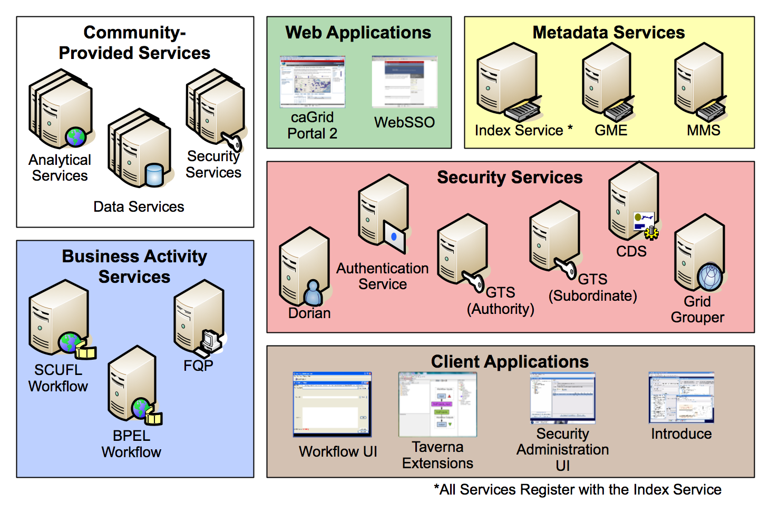
caGrid Production Environment

Slide 11
caGrid Community Involvement
caGrid itself provides no real “data” or “analysis” to caBIG™; its the enabling infrastructure which allows the community to do so
Community members add value to the grid as applications, services, and processes (for example: shared workflows)
caGrid provides the necessary core services, APIs, and tooling
The real “value” of the grid comes from bringing this information to the “end user”
Community members develop end user applications which consume of the resources provided by the grid

Slide 12

Introduce Vision
Become the one stop shop for grid service development
Provide a simple, yet powerful, graphical user interface (GUI) to encapsulate complexities of grid service development
Provide an extensible toolkit with which grid services can be created and modified programmatically

Slide 13
Introduce Overview
A framework which enables fast and easy creation of Globus based grid services
Provide easy to use graphical service authoring tool.
Hide all “grid-ness” from the developer
Utilize best practice layered grid service architecture
Integration with other core grid services and architecture components
GAARDS Security Infrastructure
Globus Index Service
Global Model Exchange
Metadata Model Service
Cancer Data Standards Repository
Extension Framework for integrating with other architecture components

Slide 14
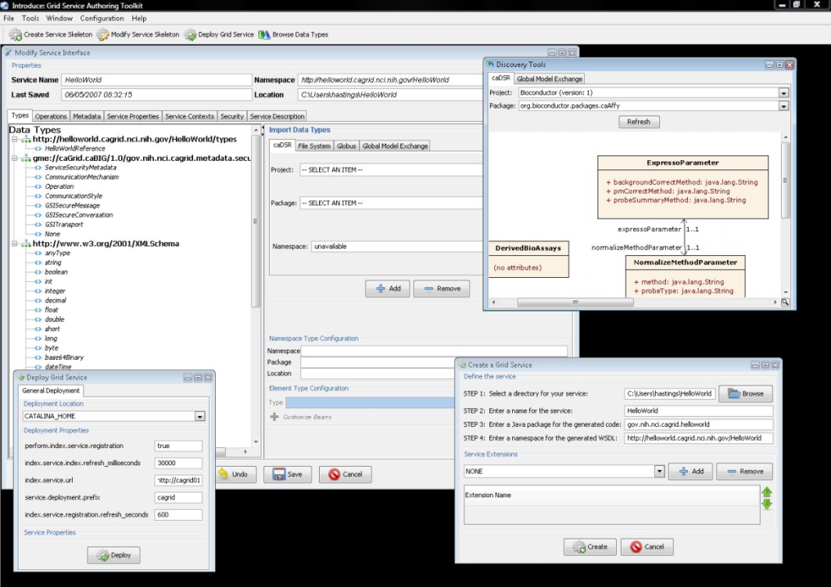
Introduce Features
Supports modification of operations
Adding operations
Removing Operations
Updating Operations
Importing Operations
Graphical Configuration
Advertisement
Security
Service Metadata Specification
Service Metadata Editing
Service Configuration Properties
Auto Generates Code for Service
Auto generates a client API for service.
Graphical Deployment of Service
Globus
Tomcat
JBoss

Slide 15
Introduce Requirements
Utilize best practice layered grid service architecture
Enable development of strongly-typed services
discovery and use of published data types
self describing services through use of metadata
advertisement and registration configuration with Index Service
Generate meaningful object-oriented client APIs
Customizable and extensible via the use of plug-ins
Allow for implementation of secure services
provide customizable service-, method-, and resource- level security

Slide 16
Service Layers

Slide 17
Addressing Strong Typing
Strongly typed interfaces:
Introduce enables schema extraction from a GME or any other data model registry service so that the wsdl, beans, and service metadata can be automatically populated and the service will be using strongly typed with publicly accessible data types.
Data model schema, and any referenced schemas, are extracted and placed in the schema directory of the services build skeleton and imported into the services WSDL.
types can be used at service build time to automatically generate the objects and create strongly-typed grid service interfaces
Example from caGrid

Slide 18
Addressing Service Registration
Index Service Registration
Leverage Globus MDS in order to configure properties on the base resource of the service to be published to an MDS based Index Service.
Provide configuration options for registration of static and dynamic service metadata which can then be used at runtime for service discovery.
Example from caGrid

Slide 19
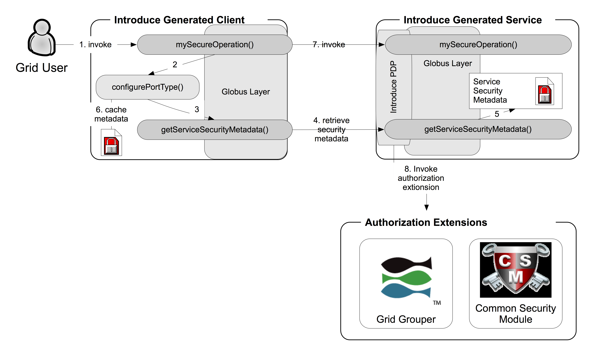
Addressing Configurable Security
Security:
Enable configuration for each service and for each method in a service so the client can utilize this metadata to configure itself for connecting to the service.
Support complete GSI security configuration for authentication and support for an authorization plug-in framework.
Require service security metadata to be available anonymously via the grid service interface (getServiceSecurityMetadata()) or the grid service’s resource properties.
Introduce generated clients will automatically retrieve this metadata and use it to configure the client before making a call to the service.

Slide 20
Analytical Service Overview
caGrid Analytical Services provide the ability to process, transform, and analyze the data exposed by a Data Service
The analytical services, just as the data services, will take in and return strongly typed and semantically harmonized data types
Graphical Development tool, implemented as an extension to the Introduce Toolkit, is used to create all Grid services
Introduce creates the service skeleton (shell) that you as a developer implement
Graphically define types used in the service, create service operations, add service contexts, utilize Introduce service extensions, and more

Slide 21
Service Contexts
A service context is a service, same as the primary (main) service
Each service context has an associated resource that holds data for the context
Each context is typically conceptually tied to an owner of that context

Slide 22
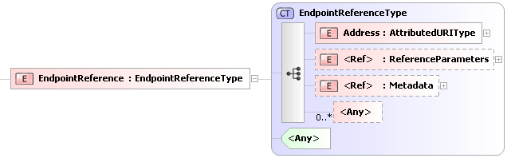
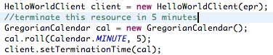
Stateful Web Services
A resource holds state. The context provides operations that typically act on that state. The client uniquely identifies the context and associated resource they would like to act on by using an EPR when connecting to the service. The EPR contains the information for locating the service as well as the id for the resource.

Slide 23
Features of Service Contexts
A service context is the name for every service developed within one introduce, with the exception of the first (main) service.
Service contexts share the service configuration i.e. service properties of the primary service.
Service contexts know how to access every other service context and the primary service resource home in order to factory new resources, find resources, and get the currently addressed resource.
Service contexts will each independently register with index service using the same configuration as the primary service.
Service contexts do have resource properties just like every other service and have operations just like every other service.
Service contexts all have there own unique endpoints and to the outside world are unique web services indistinguishable from the fact they were developed and bundled together.
Service contexts are all deployed together with the primary service to the grid service container.

Slide 24
GAARDS Overview
Grid Authentication and Authorization with Reliably Distributed Services (GAARDS)
GAARDS provides services and tools for the administration and enforcement of security policy in an enterprise Grid.
Developed on top of the Globus Toolkit
Extends the Grid Security Infrastructure (GSI)
Provide enterprise services and administrative tools for:
Grid User Management
Identity Federation
Trust management
Group/VO management
Access Control Policy management and enforcement
Integration between existing security domains and the grid security domain
Delegation
Web Application integration

Slide 25
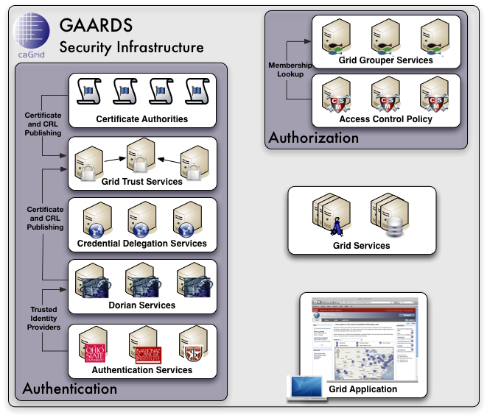
GAARDS In Action
To access secure Grid resources, a user needs to obtain a Grid credential

Slide 26
GAARDS In Action

Slide 27
GAARDS In Action
Authenticate with local institution and obtain proof of authentication (SAML Assertion)

Slide 28
GAARDS In Action
Obtain Grid Credential from Dorian using SAML Assertion

Slide 29
GAARDS In Action
Invoke Secure
Grid Service
Using Credential Provided by Dorian

Slide 30
GAARDS In Action
Validate that the
Credential provided by the user is issued by
a trusted provider

Slide 31
GAARDS In Action
Determine if user is authorized to access requested resources.

Slide 32
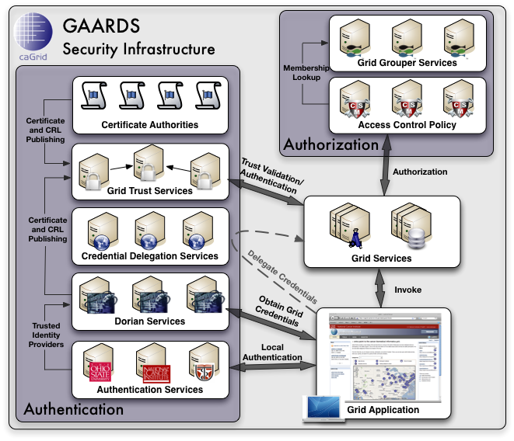
GAARDS Security Infrastructure

Slide 33
Hackathon tutorial

Slide 34
Creating a Secure Tomcat Container
Begin Secure Tomcat Deployment
These steps use a caGrid Installer that has been configured to use a local Tomcat installer rather than download from the Apache web site. This is to avoid the time required to perform the download.
Note: the caGrid will be configured to use the Community Training Grid. You must synchronize with the Community Training Grid trust fabric first.
Open a Windows Command Prompt
Click “Start”->”Run” and type “cmd”, then press the Enter key
Change to the hackathon directory
%> cd c:\hackathon
Synchronize with Community Training Grid trust fabric
%>ant syncWithTrustFabric
Execute the provided installer batch
%>ant installLocal

Slide 35
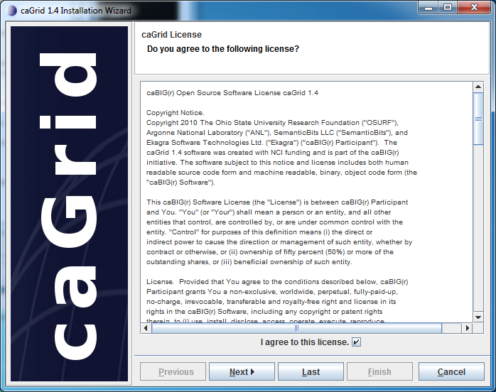
Creating a Secure Tomcat Container
Select the "I agree to this license" checkbox and click the "Next" button.

Slide 36
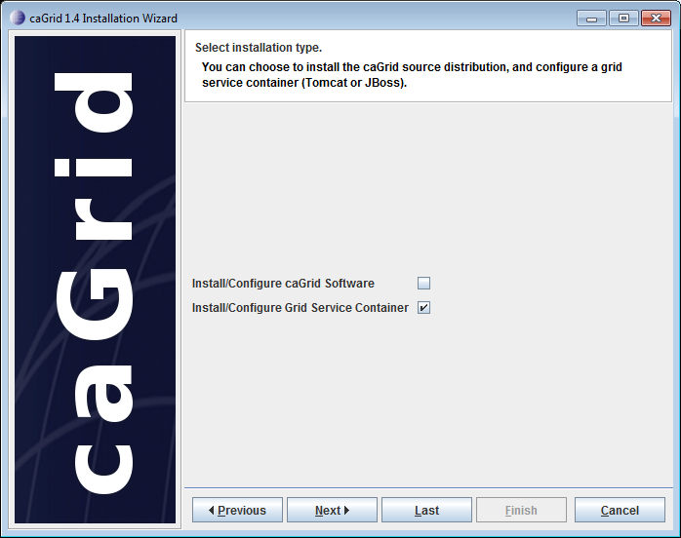
Creating a Secure Tomcat Container
Select the "Install/Configure Grid Service Container" checkbox. De-select the “Install/Configure caGrid Software” checkbox. Click the "Next" button.

Slide 37
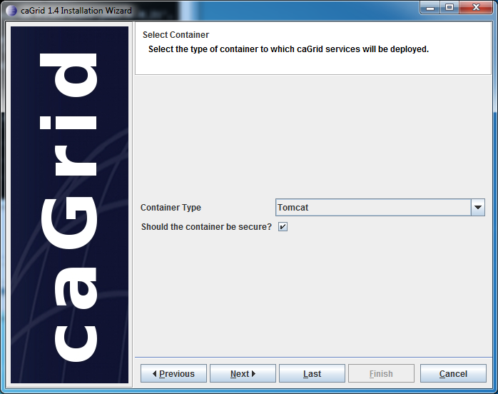
Creating a Secure Tomcat Container
Select Tomcat as the Container you would like to install.
Check the box "Should this container be secure?" and click the "Next" button.

Slide 38
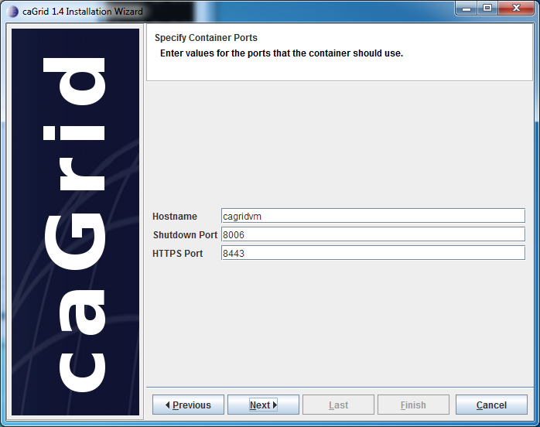
Creating a Secure Tomcat Container
We will use the default hostname and ports identified by the Installer. Click the "Next" button.
Note:
In real word usage the hostname must
be externally routable and fully-qualified
name or IP Address.
For example, the Training Grid Master
GTS external hostname is
mastergts.training.cagrid.org and
internal, non-routable hostname is ‘
cagrid-1_4-training-master-gts.cagrid.org.
We specified mastergts.training.cagrid.org.

Slide 39
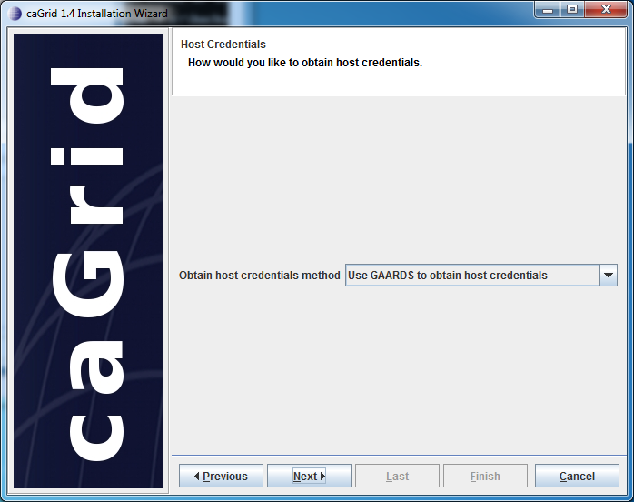
Creating a Secure Tomcat Container
Obtain Grid account and Host Certificate
In order to deploy a secure container to the Grid you must have host certificates that have been created by the Dorian Service. Using these steps you will register an account and obtain host certificates using the GAARDS UI.
Select the “Use GAARDS to obtain host credentials” option to create credentials and click the "Next" button.
The GAARDS UI will automatically open.
If it does not, open a new command prompt and change to the GAARDS UI directory:
%> cd c:\hackathon
Then run ant security:
%> ant security

Slide 40
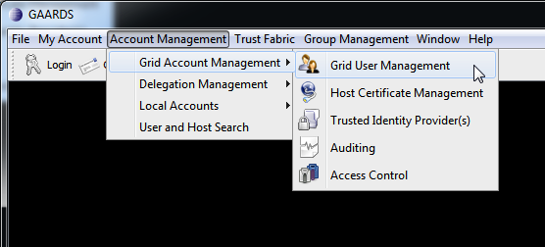
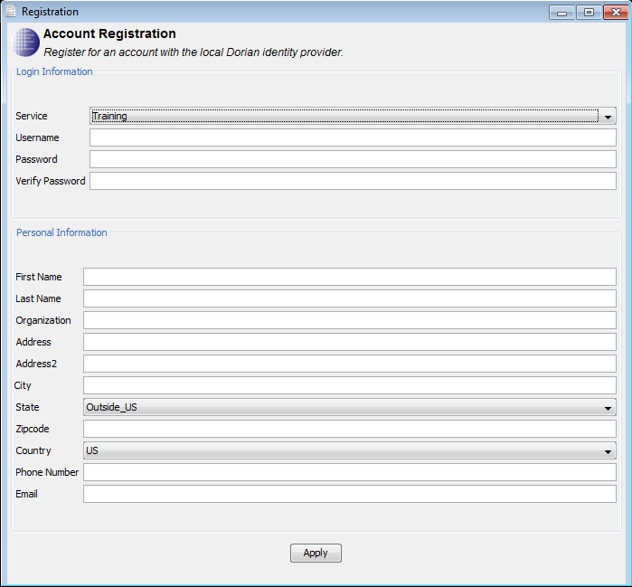
Creating an Account on the Training Grid
Register with GAARDS
Note: if you have an NCI account (or KC account), you can skip this step.
Click the Account Management Menu item, then select Local Accounts->Registration.
Provide the requested information,
Click Apply.
Note on password requirements: A valid password must be between 10 and 20 characters and CANNOT contain a dictionary word. It MUST contain at least one upper case letter, at least one lower case letter, at least one number, and at least one symbol (~!@#$%^&*()_-+={}[]|:;<>,.?)

Slide 41
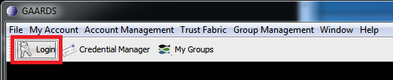
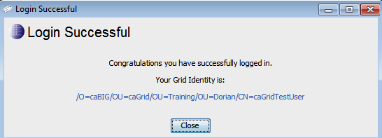
Creating an Account on the Training Grid
Login to the Community Training Grid
Click the "Login" button.
In the Login dialog, enter your “User ID” and “Password” and click the “Login” button.
Note: if you are using your NCI/KC username and password, select the NCI organization. Otherwise, use the default of “Training”.
Jot down this identity

Slide 42
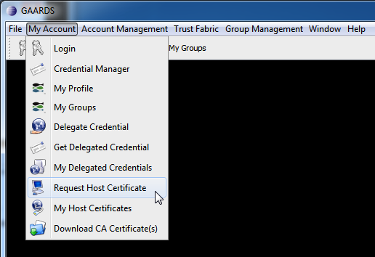
Obtaining a Host Certificate
Request Host Certificate
Host certificates are used to establish secure communications between clients and services.
Open the "Request Host Certificate" Panel via the "My Account" menu and "Request Host Certificate” menu item.

Slide 43
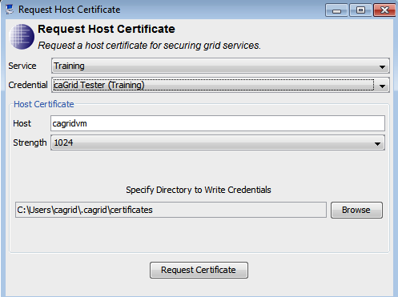
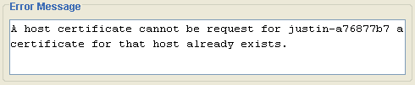
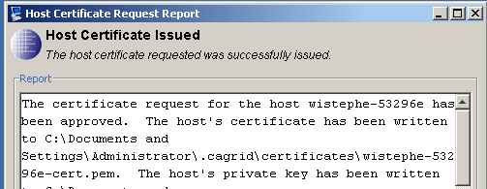
Obtaining a Host Certificate
Accept the Host name that GAARDS identifies.
Accept the default location for creating the host credentials. On Windows, this will be a path like "C:\Documents and Settings\<USERNAME>\.cagrid\certificates”.
Click Request Certificate. A dialog will display the outcome of your request.
Note: if you receive an error (see right), then follow the steps on the next slides. You will see the “Host Certificate Issued” dialog to the lower right after a successful request. Note the location of the certificate and key as shown in the dialog.
Close the GAARDS UI.
Click the Next button on the installer.

Slide 44
Host Certificate Error
If you receive the error similar to the one to the right, raise your hand to get assistance from a caGrid admin.

Slide 45
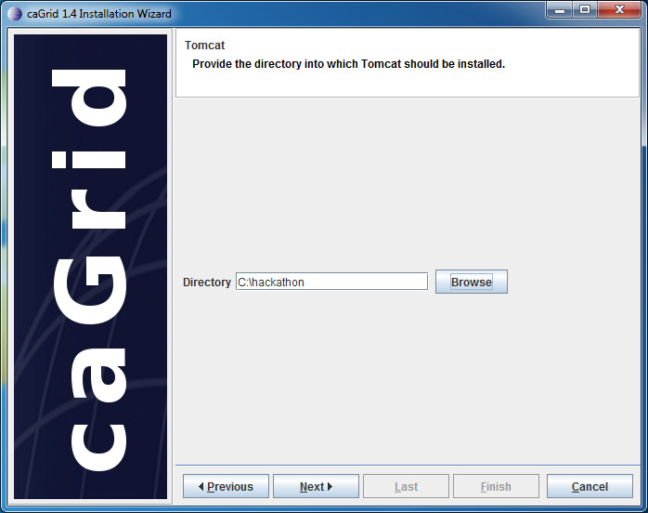
Creating a Secure Tomcat Container
Completing the Tomcat Installation
Please enter C:\hackathon in the "Directory" text box and click the Next button.

Slide 46
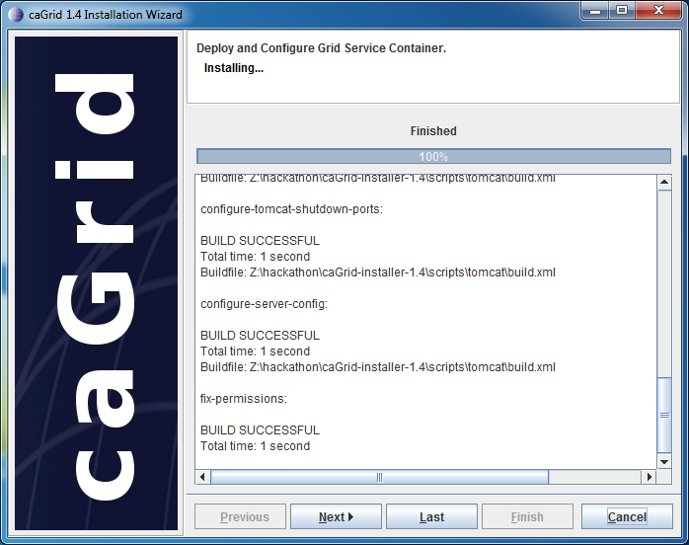
Creating a Secure Tomcat Container
The next screen will display a list of tasks that the installer will perform to install and configure tomcat, click Next.
Once the installer has completed installing all the components, click the "Next" button.
The final screen asks you to set the following environment variables: ANT_HOME, GLOBUS_LOCATION and CATALINA_HOME. (The values displayed should match the values used while configuring your machine earlier.)
Click Finish.
Click Close.

Slide 47
Create the caGrid Service Skeleton
This phase of this tutorial involves starting the Introduce toolkit and using it to create the skeleton of the new grid service.
Open a Windows Command Prompt
Click “Start”->”Run” and type “cmd”, then press the Enter key
Change directory to the caGrid Installation
%> cd c:\hackathon
Start Introduce using the provided Ant task
%> ant introduce

Slide 48
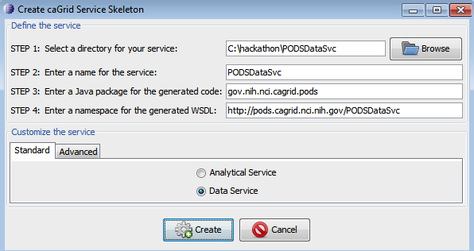
Create the caGrid Service Skeleton
Create the caGrid Service Skeleton
Click Create caGrid Service Skeleton button on the toolbar at the top of the Introduce portal. The Create caGrid Service Skeleton screen will appear (see right).
Type the following as your service directory “C:\hackathon\PODSDataSvc”.
Type “PODSDataSvc” in the Service Name field.
Type “gov.nih.nci.cagrid.pods” in the Package Name field.
Verify that the Namespace field contains “http://pods.cagrid.nci.nih.gov/PODSDataSvc”.
Select the “Data Service” option.
Click the “Create” button.

Slide 49
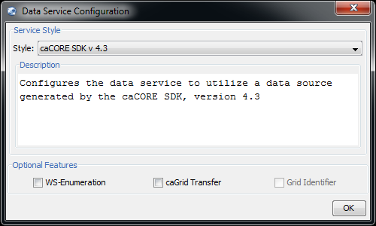
Create the caGrid Service Skeleton
Select the Service Style
The caGrid data services extension provides a pluggable framework for creating highly custom data services known as data service styles. Styles may be provided by a third party, or installed with caGrid. Styles are provided to create data services backed by various versions of the caCORE SDK.
When the Data Service Configuration window appears, use the drop down menu to select the caCORE SDK v 4.3 option.
Leave the check boxes for
WS-Enumeration and caGrid Transfer
unchecked for this tutorial.
Click the OK button.

Slide 50
Phase 3: caCORE SDK 4.3 Data Service Style (1)
The caCORE SDK v. 4.3 Data Service style provides a wizard interface which is run prior to generation of the data service's source code. This wizard provided facilities to select the client interface to the caCORE SDK and configure it, as well as selection of a domain model and mapping that domain to XML schemas for use on the grid.
The wizard displays the current step in the lower left hand corner of the window, and provides simple 'Previous' and 'Next' buttons to navigate the steps.

Slide 51
caCORE SDK 4.3 Data Service Style (2)
Providing information about the caCORE PODS Application
The first step of the caCORE SDK v 4.3 Data Service Creation Wizard asks the service developer to provide information about the caCORE Application.
Type “pods” for the Application Name.
Check the box for “Use JaxB Serialization”
Select the “Remote API” option from the API Type group.
Click the “Browse” button to the right of the Local Client Dir text box.
Browse and select the “C:\hackathon\pods-project\local-client” directory.
Click the “Browse” button to the right of the Remote Client Dir text box.
Browse and select the “C:\hackathon\pods-project\remote-client” directory.
Enter “tutorials.training.citih.osumc.edu” as the Application Host Name.
Enter “8080” as the Application Port Number.
Leave the Use HTTPS Connections option unchecked.
Click the “Next: Security” button.

Slide 52
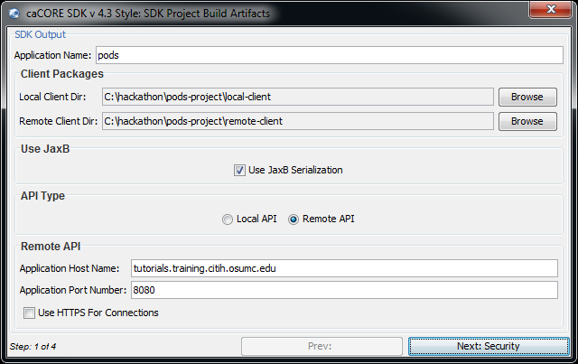
caCORE SDK 4.3 Data Service Style (3)

Slide 53
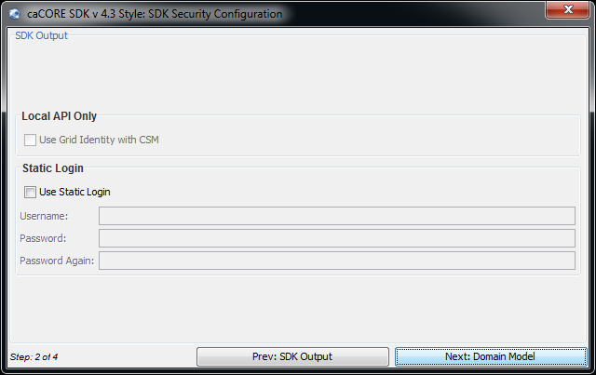
caCORE SDK 4.3 Data Service Style (4)
Log In to the caCORE SDK Application
Step two allows the service developer to supply the security login information to the caCORE SDK Application Service in the form of a username and password combination. If these values are supplied, the caCORE SDK Application Service API will be use the given username for all queries.
Click “Next: Domain Model”
as we will not use a login in this
tutorial.

Slide 54
caCORE SDK 4.3 Data Service Style (5)
Select the Domain Model
Step three of the wizard requires the service developer to supply the domain model for the new data service. The domain model defines the classes, their attributes, and relationships such that data services may be discovered using the data types. Most importantly, CQL queries can be formulated using the domain model.
There are two potential sources for the domain model:
Default XMI: This setting directs the wizard to convert the XMI model which is used by the caCORE SDK system specified on step 1 as the domain model. The XMI will be converted to a domain model XML document.
Pre-Generated: This option allows the service developer to specify a pre-generated domain model XML document from the local file system.

Slide 55
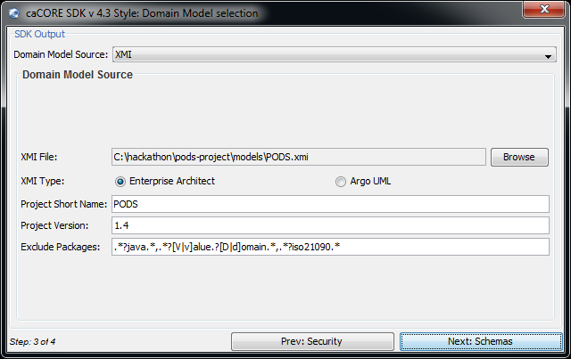
caCORE SDK 4.3 Data Service Style (6)
Select the Domain Model (continued)
For this tutorial, select XMI as the Domain Model Source.
Click the “Browse” button to the right of the XMI File text box.
Browse and select the “C:\hackathon\pods-project\models\PODS.xmi” file.
Select “Enterprise Architect” for the XMI Type
Type “PODS” for the Project Short Name
Type “1.0” as the Project Version to create a caGrid version of your Domain Model. Verify the other fields are as shown in the picture below.
Click the “Next: Schemas” button.

Slide 56
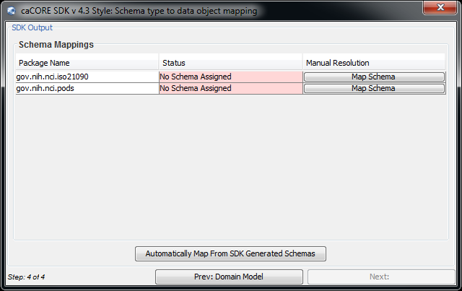
caCORE SDK 4.3 Data Service Style (7)
Map XML Schema to Model Packages
Every class included in the domain model must have a corresponding XML schema representation so the data may be sent across the grid. The mapping panel of this wizard streamlines this process by simultaneously generating the mapping from model to schema and configuring serialization of the XML data types to correspond to the domain model's Java beans.
The table shows the following information: 1) packages included in the domain model, 2) the current mapping status of the package, and 3) a “Map Schema” button to manually resolve the mapping for each package. The Automatically Map From SDK Generated Schemas button in the bottom of the panel makes use of the XML schemas provided by the caCORE SDK to map each package of the domain model.

Slide 57
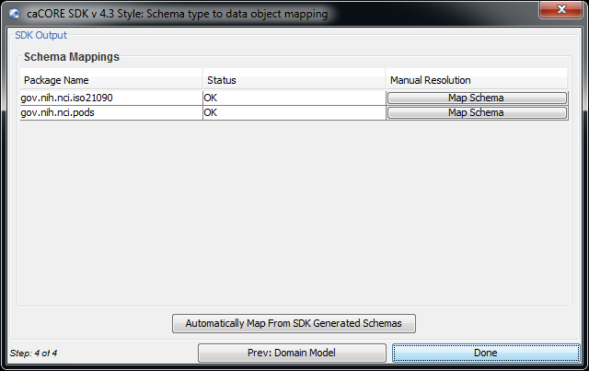
caCORE SDK 4.3 Data Service Style (8)
Map XML Schema to Model Packages (continued)
Click the Automatically Map From SDK Generated Schemas button to perform the mapping from domain model packages to XML schema.
Verify that the “Status” field changes from “No Schema Assigned” to “OK”.
Click Done to complete the wizard.

Slide 58
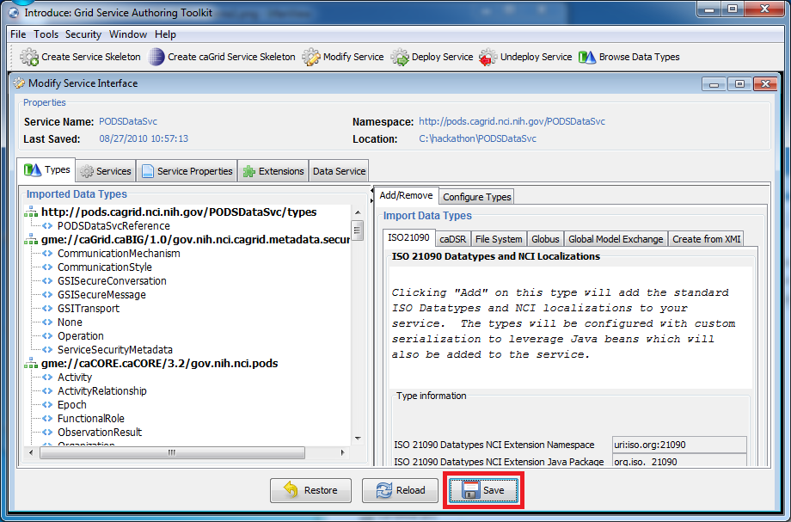
caCORE SDK 4.3 Data Service Style (9)
Save your Service!
You will see a progress bar during creation of your caGrid Data Service.
Click the Save button at the bottom of the "Modify Service Interface”. Note: click Yes if it asks you to confirm the save.

Slide 59
Phase 4: Set Service Metadata (1)
Service Metadata contains information about the developer of the service, the maintainer or administrator of the service and the hosting research center as well as optional information such as a web site URL. This information is used when registering your service with the Index Service for the Grid and is accessible via the caGrid Portal.
In order to deploy your Grid service via Introduce or the command line you will need to set the service metadata.

Slide 60
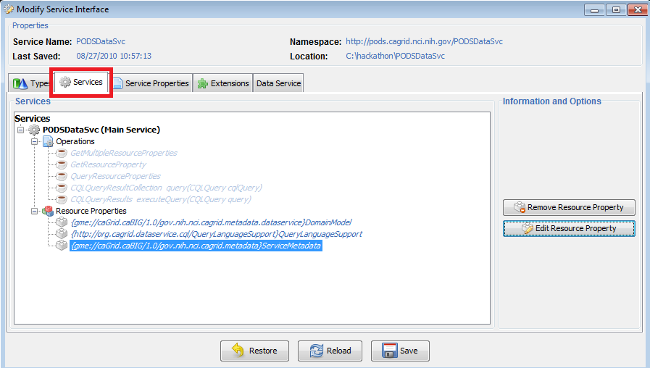
Set Service Metadata (2)
Open the Introduce Service Metadata Resource Property Editor
Click the Services tab of your Grid service.
Underneath ”PODSDataSvc", click the ServiceMetadata Resource Property
Click the Edit Resource Property button, on the right.

Slide 61
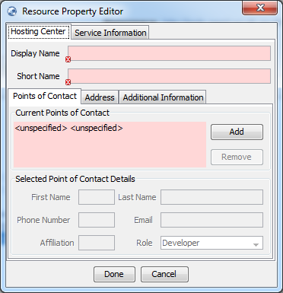
Set Service Metadata (3)
The Resource Property Editor The Resource Property Editor allows you to define your service metadata. Required fields will be identified by a pink background and a red "x”.

Slide 62
Set Service Metadata (4)
Hosting Center and Point of Contact
Hosting Center and Point of Contact fields identify where the service is deployed and an individual responsible for the service such as an administrator.
Type “2010 caBIG Annual Meeting” in the Display Name field.
Type “annualmeeting” in the Short Name field.
Click “<unspecified>” in the Current Points of Contact.
Type your first name in the First Name field.
Type your last name in the Last Name field.
Type your email in the Email address field.
Type your Affiliation. Ex. Your department
Select the “Maintainer” Role.

Slide 63
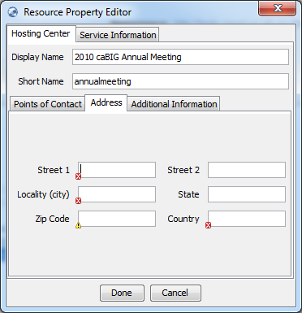
Set Service Metadata (5)
Hosting Center Address
Provide the address of your Hosting Center. For this tutorial we'll use the hotel’s address: 2660 Woodley Road NW Washington, DC 20008
Click the Address Tab
Set “2660 Woodley Road NW” to Street 1 field.
Leave Street 2 empty.
Set “Washington” in the Locality(City).
Set “DC” as the 2-character State abbreviation.
Set “20008” as the Zip Code.
Set "US” as the 2-character Country Code.

Slide 64
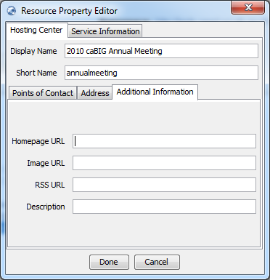
Set Service Metadata (6)
Hosting Center Additional Information
This tab provides you with the ability to supply metadata that allows users to find more information about you. All fields are optional.

Slide 65
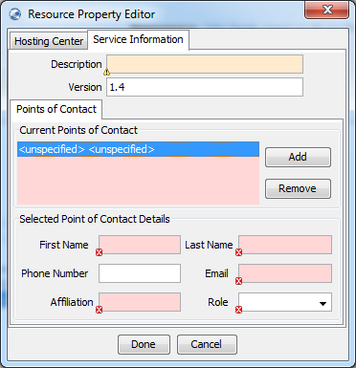
Set Service Metadata (7)
Service Information Point of Contact
The Service Information tab provides information about a POC for the Service itself.
Click “Service Information” tab.
Click “<unspecified>” in the Current
Points of Contact panel.
Type your first name in the First
Name field.
Type your last name in the Last
Name field.
Type your email in the Email address
field.
Type your Affiliation. Ex. Your
department
Select the “Developer” Role.
Click “Done” to finish editing metadata.
Note: If you have missed a required field you will get an error message.

Slide 66
Set Service Metadata (8)
Save Your Service!
Remember to save your service. Introduce will allow you to roll back to a save point. This can be very useful in the event that you run into problems.
Click the Save button at the bottom of the "Modify Service Interface”. Note: click Yes if it asks you to confirm the save.

Slide 67
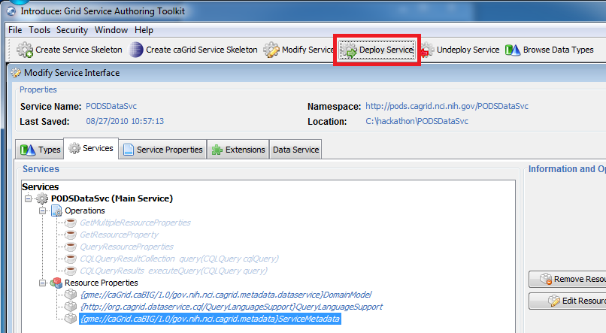
Phase 5: Deploy the Grid Data Service
The caGrid data service has been created. It must be deployed to a container and started so that it can be invoked. This tutorial uses the secure Tomcat container that you configured earlier.
Select a Grid Service to Deploy
In Introduce, click the “Deploy Service” button.

Slide 68
Deploy the Grid Data Service (2)
Browse to the C:\hackathon\PODSDataSvc folder
Click Open.
Deploy the Grid Data Service
Select Tomcat as the target Grid Container.
Click the Advanced Deployment tab.
Uncheck the “Perform Registration” checkbox (to not perform registration)
(Optional) View the Domain Model by clicking the Domain Model Viewer tab.
Click the General Deployment tab.
Click the Deploy button.

Slide 69
Deploy the Grid Data Service (3)
Starting Tomcat
Start the Tomcat container so that the service can be invoked.
Open a Windows Command Prompt
Click “Start”->”Run” and type “cmd”, then press the Enter key
Change directory to your Tomcat directory
%> cd %CATALINA_HOME%\bin
Start Tomcat
%> startup.bat
A new Windows command window will open and will contain the startup information from your Tomcat.

Slide 70
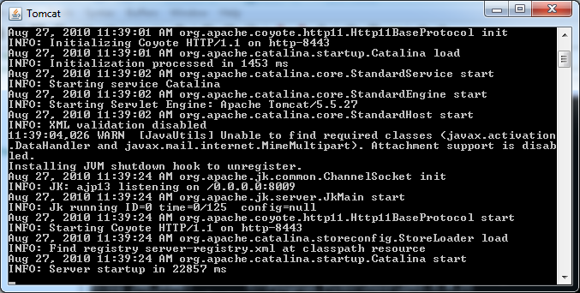
Deploy the Grid Data Service (3)
Example Tomcat Startup Output

Slide 71
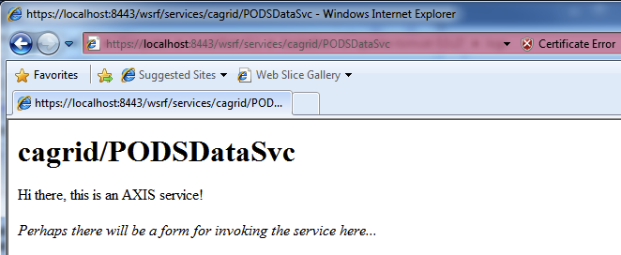
Deploy the Grid Data Service (4)
Verify Service Deployment
Open Internet Explorer
Go to: https://localhost:8443/wsrf/services/cagrid/PODSDataSvc
Click “Yes” (or “Continue to this website”) if prompted for a “Security Alert”.

Slide 72
Phase 6: Test Files (1)
The Test Files
The Person Query (C:\hackathon\caGridClient\personCQL2Query.xml)
The following query will return all the Person objects (that are instances of the Person class in the data model)
<ns1:CQLQuery xmlns:ns1="http://CQL.caBIG/2/gov.nih.nci.cagrid.cql.Components">
<ns1:CQLTargetObject className="gov.nih.nci.pods.Person"/>
</ns1:CQLQuery>

Slide 73
Test Files (2)
Specific Person Query
(C:\hackathon\caGridClient\doeCQL2Query.xml)
The following query will return the Person defined with the Last Name of “Doe”
<cql2:CQLQuery xmlns:cql2="http://CQL.caBIG/2/org.cagrid.cql2">
<cql2:CQLTargetObject className="gov.nih.nci.pods.Person">
<cql2:CQLAssociatedObject className="gov.nih.nci.iso21090.EnPn" endName="name">
<cql2:CQLAssociatedObject className="gov.nih.nci.iso21090.Enxp" endName="part">
<cql2:CQLAttribute name="value">
<cql2:BinaryPredicate>EQUAL_TO</cql2:BinaryPredicate>
<cql2:AttributeValue>
<cql2:StringValue>Doe</cql2:StringValue>
</cql2:AttributeValue>
</cql2:CQLAttribute>
</cql2:CQLAssociatedObject>
</cql2:CQLAssociatedObject>
</cql2:CQLTargetObject>
</cql2:CQLQuery>

Slide 74
Run the Tests (1)
All caGrid Data Services can be queried using the DataServiceClient that is distributed with caGrid. A grid client that uses this API has been created to interact with the PODS Data Service. The client will submit queries to the data service and present the results to you.
For detailed information about the development of grid client applications, including invocation of PODSDataSvc services, please read the caGrid Client Application Guide:
http://cagrid.org/display/knowledgebase/Client+Application+Guide

Slide 75
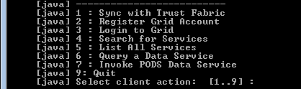
Run the Tests (2)
Start the caGridClient
Open a Windows Command Prompt.
Click “Start”->”Run” and type “cmd”, then press the Enter key
Change directory to our caGrid Data Service.
%> cd C:\hackathon\caGridClient
Run the Client using the provided Ant task %> ant run
The client will build and present you with the following options:

Slide 76
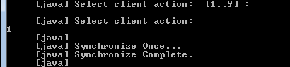
Run the Tests (3)
Sync with Trust Fabric
The caGridClient provides the ability to synchronize with the grid Trust Fabric using the API provided by the SyncGTS client that is distributed with caGrid.
Type “1” to synchronize with the grid trust fabric.
The client will connect to the Training Grid Slave GTS service to obtain the grid CA certificates.

Slide 77
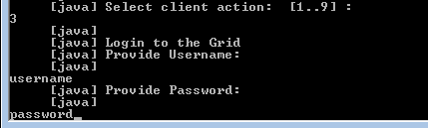
Run the Tests (4)
Login to the Grid
The caGridClient uses a local copy of your user credential when accessing secure grid services. You will need to login using the client in order for your credential to be saved to the expected location on your computer.
At the main client prompt, Type “3” to login to the grid.
Type your grid username, then hit the Enter key.
Type your password, then hit the Enter key.

Slide 78
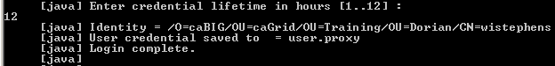
Run the Tests (5)
Credential Lifetime
The credential that you obtain from Dorian has a lifetime associated with it. You will be prompted to specify the duration during which the credential is valid.
When prompted for the credential lifetime, type “12”.
Your login request will be submitted.

Slide 79
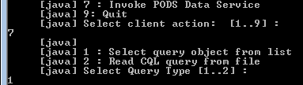
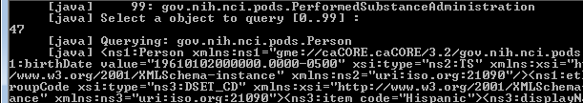
Run the Tests (6)
Query the Data Service with Object from Domain Model
This test will obtain the service domain model and allow you to select from the available data types presented by the data service.
Type “7” to Query the PODS Data Service.
You are presented with 2 options:
Type “1” to query using the objects in the domain model
You will see a list of available data types:

Slide 80
Run the Tests (8)
Type “47” to query for Person.
The client will connect to the secure data service and provide your credential in order to securely invoke the service.
You will see a message that the query has started and then be presented with the query output. You should see 6 people.

Slide 81
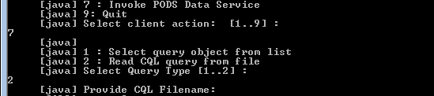
Run the Tests (9)
Query the Data Service with CQL
This test will obtain a CQL query from a file and submit the CQL to the query operation of the data service.
Type “7” to Query the PODS Data Service.
You are presented with 2 options:
Type “2” to query using a CQL file.

Slide 82
Run the Tests (10)
Type “personCQL2Query.xml”, then press the Enter key.
The CQL2 query will be read from the file and a CQLQuery object will be submitted as input to the data service query operation.
You should see results that are identical to the previous query (Person class) in the queryResults.xml .
Type “0” to quit the client.

Slide 83
Phase 7: Add Security
In this section of the lesson, we will enable security on our service.
In the next steps, we will enable service-level authentication requirements. This means we will have the following requirement for every service client: they are logged in so that the service can verify their identity
We will use Introduce to configure our security policy. Then we will re-deploy our service so that we have our new security policy enabled.

Slide 84
Add Security (2)
This phase of this tutorial returns to the Introduce toolkit and using it to add security to your data service.
If you closed the Introduce toolkit from earlier, here are the steps to restart it:
Open a Windows Command Prompt
Click “Start”->”Run” and type “cmd”, then press the Enter key
Change directory to the caGrid Installation
%> cd c:\hackathon\caGrid
Start Introduce using the provided Ant task
%> ant introduce
Click the Modify Service button
Browse to and select the C:\hackathon\PODSDataSvc directory

Slide 85
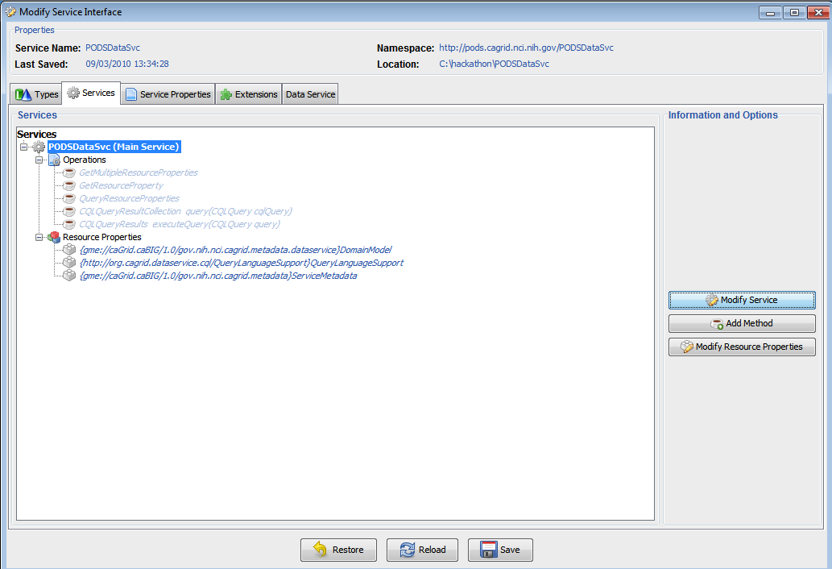
Add Security (3)
We will enable secure access to your service via Introduce.
Click the “Services” tab.
Select “PODSDataSvc”.
Click “Modify Service”.

Slide 86
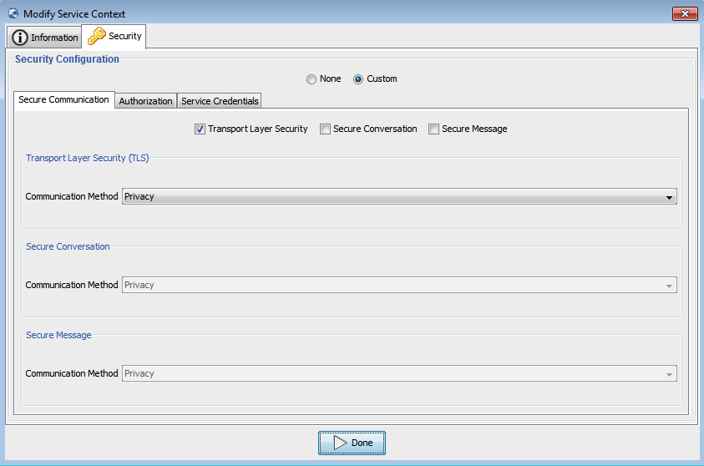
Add Security (4)
Add authentication requirements.
Click the “Security” tab.
Select “Custom”.
Check “Transport Layer Security”.

Slide 87
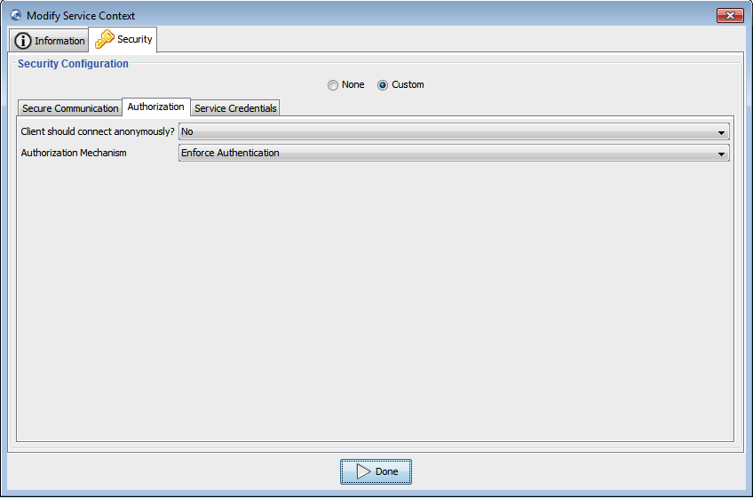
Add Security (5)
Change the Authorization Mechanism:
Select the Authorization tab
Select “Enforce Authentication” from the Authorization Mechanism drop down box.
Click the Done button

Slide 88
Add Security (6)
Save Your Service!
Remember to save your service. Introduce will allow you to roll back to a save point. This can be very useful in the event that you run into problems.
Click the Save button at the bottom of the "Modify Service Interface”. Note: click Yes if it asks you to confirm the save.

Slide 89
THE END

